Slide 1

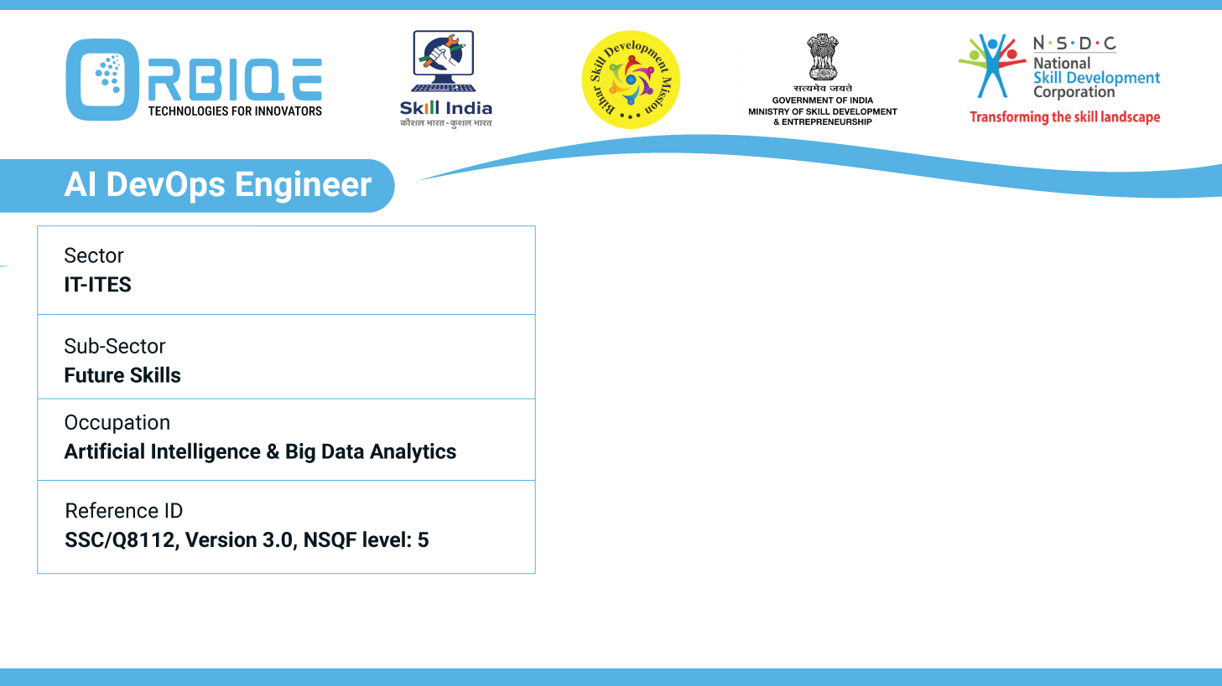
Name- Krishna Kant Dubey

Slide 2

Identifying Suitable Stakeholders for Administration

Slide 3
Agenda
Maintain CI/ CD pipelines
Code quality
Manage infrastructure, monitor system health
Define testing strategies

Slide 4
Maintain CI/ CD pipelines

Slide 5
Code quality

Slide 6
Manage infrastructure, monitor system health

Slide 7
Define testing strategies

Slide 8
Thank You

